Slide 1
COLLEGE BUS TRACKING HYBRID APP USING ADVANCED GOOGLE CLOUD SERVICES AND IOT
Mobile App Development with Cloud
NAFEEZ ABBAS J (2017PECCS307 / 211417104156)
NARESH D (2017PECCS311 / 211417104160)
SALMAN KHAN S (2017PECCS349 / 211417104232)
Under the Guidance of
Mr. S.A.K. JAINULABUDEEN
ASSISTANT PROFESSOR

Slide 2
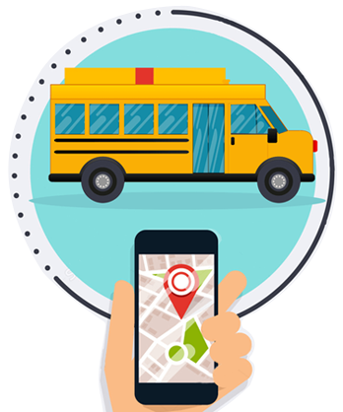
Introduction
The system includes a Mobile Application to be used by the students and a Hardware setup which shares the location of the bus. The Hardware system uses IOT which includes an Arduino UNO, GSM, GPS modules, etc. The Hardware is setup in the bus such that its location can be accessed. This location information is accessed by the mobile app via Third Party Cloud Services. And hence the students can know the location and make arrangements accordingly.

Slide 3
Literature Survey
TITLE | AUTHORS | OBJECTIVE
Location based alarm system depending on longitude and latitude | G. V. M. Vasuki | Location Based alarm using GPS is an attempt to add an alarm facility for mobiles, based on the location of the device and to find the nearest places from the current location of the mobile device. The location-based alarm will give you alert when you reach your desired destination.
Smart Vehicle Monitoring System using IOT | N.Upendra Yadav and Professor Kamalakannan | This project uses accelerometer sensor which can detect the unevenness of vehicle and vibrations when an accident is occurred. This sends a signal to microcontroller. Message notifications are sent to the mobile number which is prescribed.

Slide 4
Literature Survey
TITLE | AUTHORS | OBJECTIVE
To determine precise location of object | Abid khan and Ravi Mishra | They have proposed tracking unit which it is attached and using GSM modem this information can be transmit to remote user. Real time control is provided by SMS system. You can monitor the location from anywhere using this system.
Hybrid Mobile Application Based on Ionic Framework Technologies | Dunka, Bakwa, Emmanuel, Edim, Oyerinde and Yinka | The objectives of this research article were to analyze native, web and hybrid mobile approaches to apps development and also to demonstrate how hybrid mobile apps can be built using Ionic framework.

Slide 5
Problem Statement
Nowadays many colleges are still using the traditional way of using paper and files to keep record of the bus route and schedule as well as provides information through notices which is not effective. So, there is need of a systematic way of keeping records as well as providing information as per the need. Also, students even don’t know about the proper timing of the bus. Some students wait for the bus being unaware of that the bus had already been missed and they are late for the class. Therefore, the smart system is necessary which provides real time information of bus to remote user. So, we proposed a new system which overcome the drawback of college transportation system.

Slide 6
Development Environment
Hardware
Arduino Uno
GPS
GSM
LCD Display
Keypad
Software
Android Studio with Flutter Framework
Firebase
Arduino IDE

Slide 7
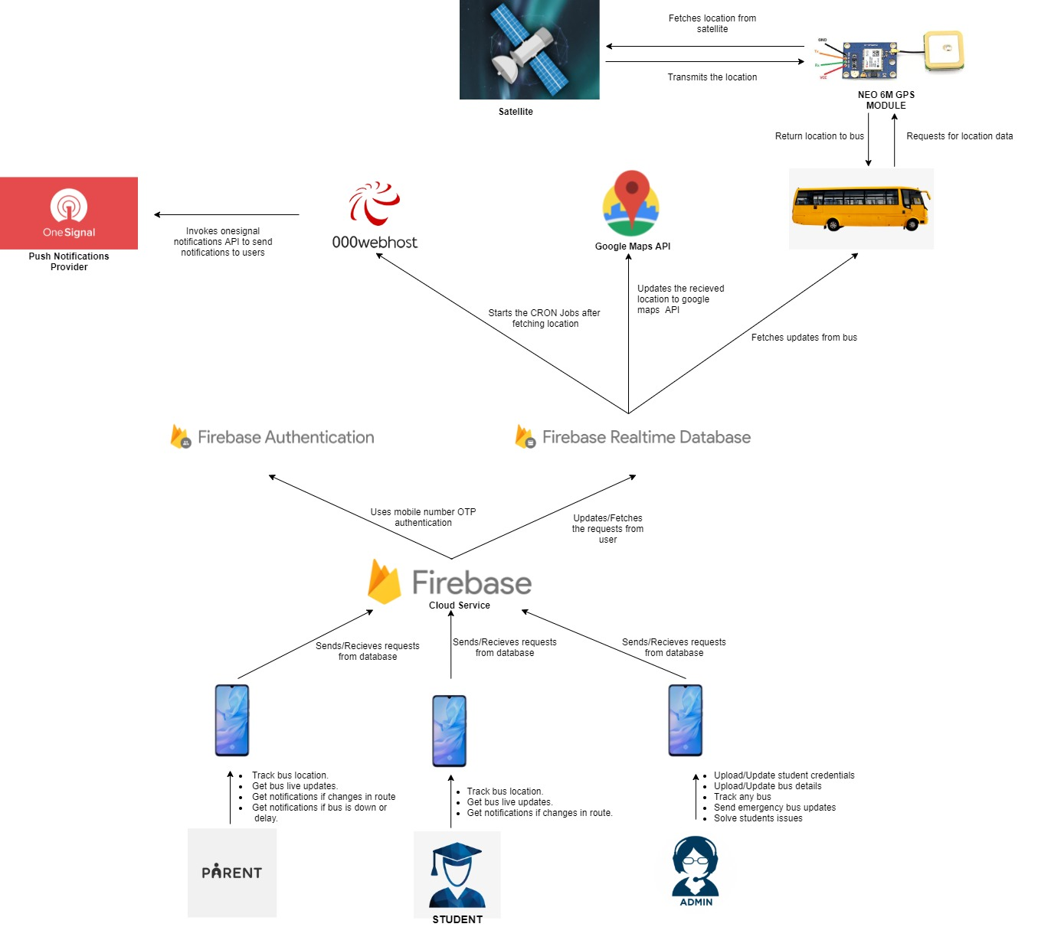
System Architecture

Slide 8
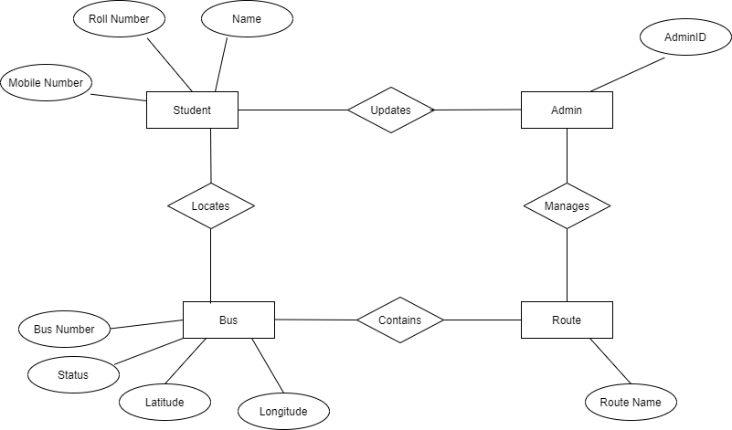
System Design – ER Diagram

Slide 9
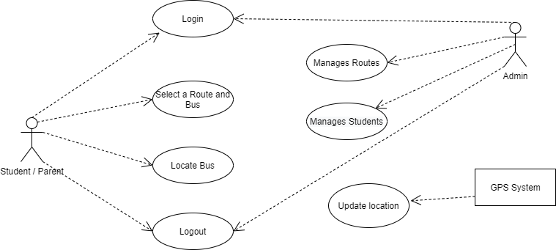
System Design – Use Case Diagram

Slide 10
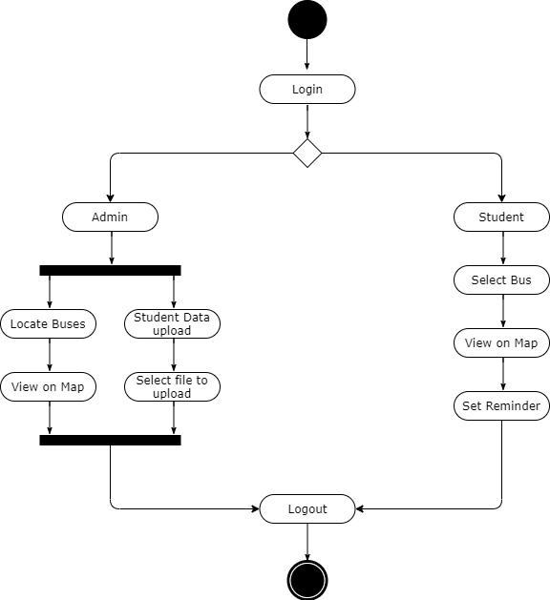
System Design – Activity Diagram

Slide 11
Module Description
Project is designed in four modules where each module is responsible for different aspects.
Student / Parent Module
Admin login Module
Firebase Module
Hardware Module

Slide 12
Modules - Admin
The admin logs into the system with user name and password, the admin manages routes, students and drivers. Admin can add and update the students details and the driver details as well. Also, the Admin manages the list of routes and the buses available in each route. All the information is made persistent in the database.
Admin manages the routes and makes changes in it if necessary.
The Admin also has the access to the location of the buses where he / she can choose the Bus Number and view its current location using the Google Maps API.

Slide 13
Modules – Student / Parent
Student can login to the system using the Unique Register Number provided to him / her by the college and the mobile number submitted. Upon successful login, the student will prompted to select the route and bus number to track it.
Students can view the location of bus in real-time on the map.
Students can also set an alarm which starts when the bus is nearing him.
Student receives updates on route and bus changes as well.

Slide 14
Modules – Firebase
Firebase provides the NOSQL database for storing the student and bus record. Lot of API's and function calls have been used in order to create, read, update, delete (CRUD) operations for user and admin data.
Other than that firebase also provides push notification facility to our app.
Adding to this, another third-party provider called as 000webhost.com used to update the bus co-ordinates from the arduino UNO to database.

Slide 15
Modules - Hardware
This module tracks and updates the bus coordinates to the database through API calls. It needs a proper working sim card with data transfer facility (GPRS).
The GPS coordinates are made persistent in a Third Party Cloud using the GSM.
The GSM makes an HTTP request to the Cloud and hence stores the coordinates which are in turn fetched at the Mobile App.
Google Map API uses these coordinated to show the location of the bus.

Slide 16
Testing
Test Case No. | Action | Expected Output | Actual Output | Result
1 | Number of characters of Roll No. is equal to 12 characters | Login button is enabled | Login button is enabled | Pass
2 | Number of characters of Roll No. is less than 12 characters | Login button is disabled | Login button is disabled | Pass
3 | Number of characters of Roll No. is greater than 12 characters | Subsequent characters are not accepted | Subsequent characters are not accepted | Pass
4 | Click Help | Displays Help screen | Displays Help screen | Pass
5 | Click Login button | Enters into OTP page, OTP is verified automatically and home page is displayed | Enters into OTP page, OTP is verified automatically and home page is displayed | Pass

Slide 17
Testing
Test Case No. | Action | Expected Output | Actual Output | Result
6 | Click Select Route | Displays the list of routes and buses available | Displays the list of routes and buses available | Pass
7 | Click OK button | Current location of the bus is displayed in the map | Current location of the bus is displayed in the map | Pass
8 | Click Reminder | Displays the popup to enable or disable the reminder | Displays the popup to enable or disable the reminder | Pass
9 | Click Updates | Displays the updates of the bus | Displays the updates of the bus | Pass
10 | Click Log out button | Logout from the app | Logout from the app | Pass

Slide 18
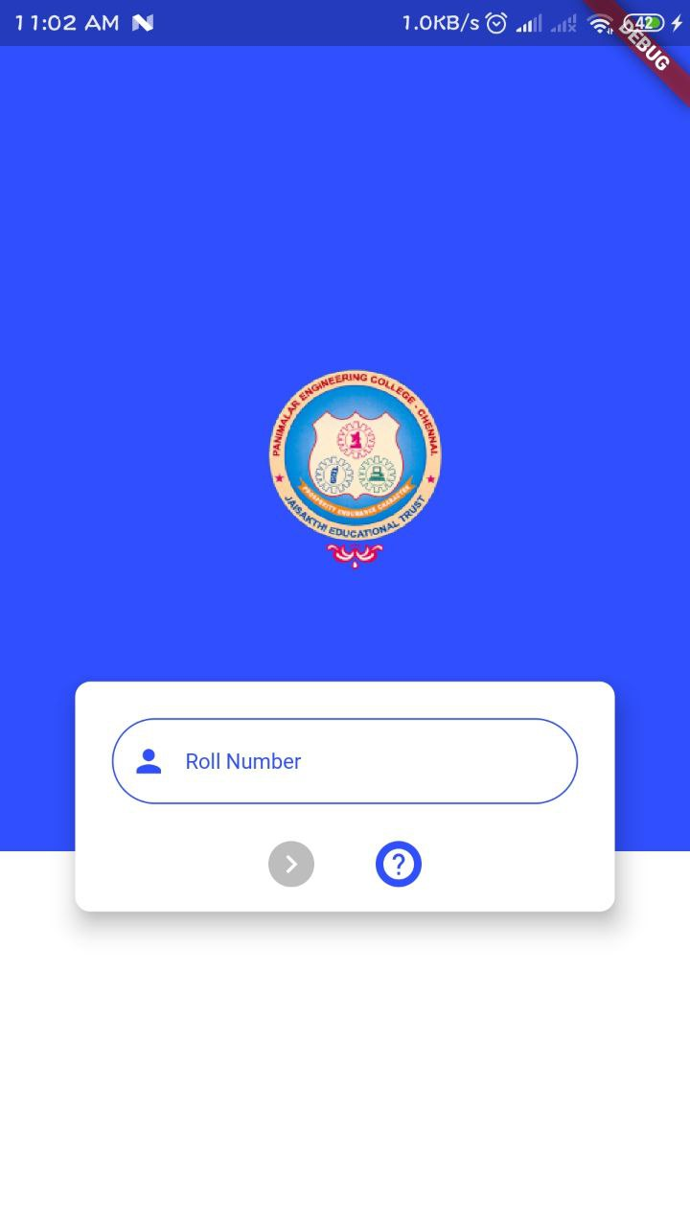
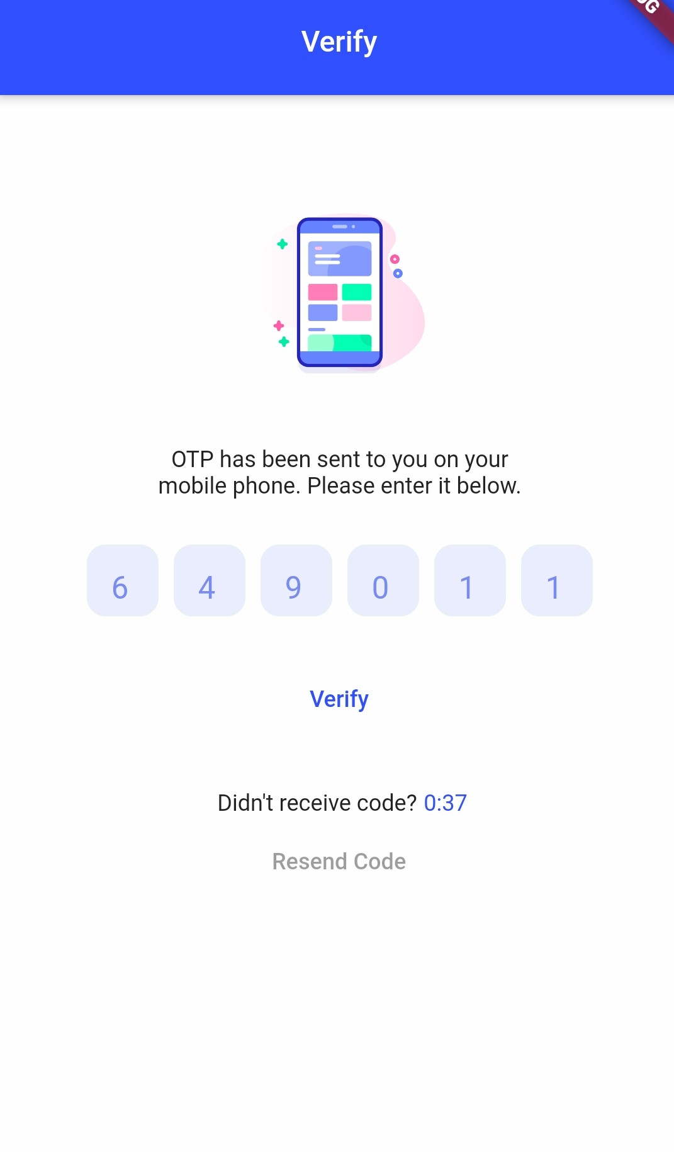
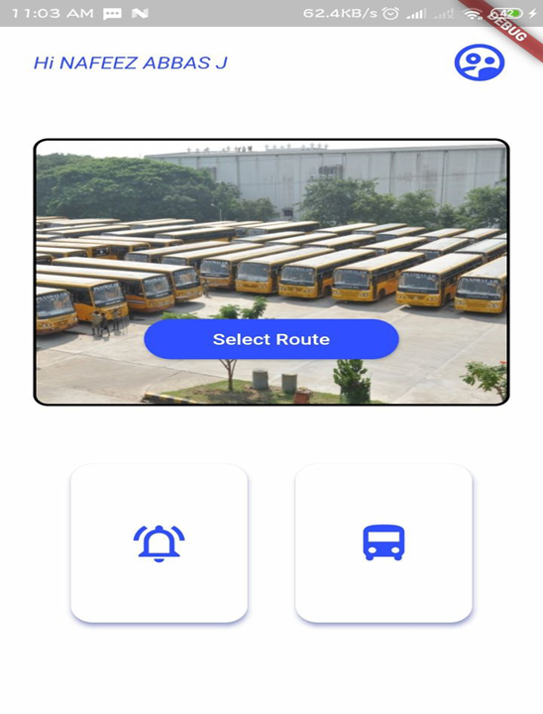
Screenshots

Slide 19
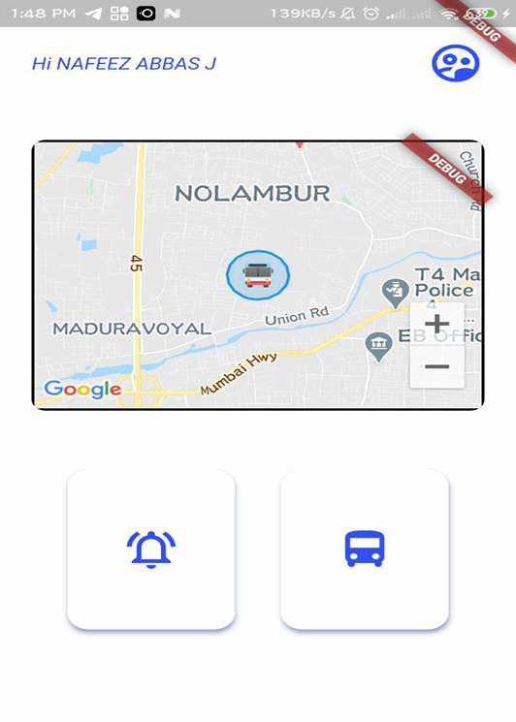
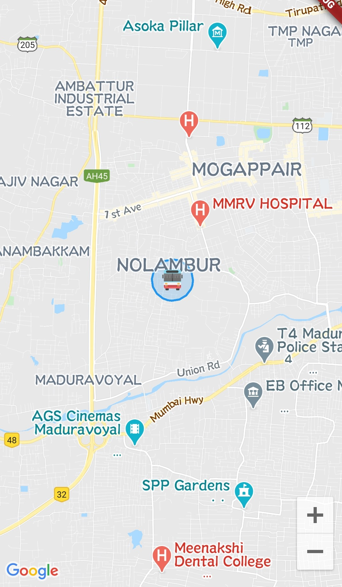
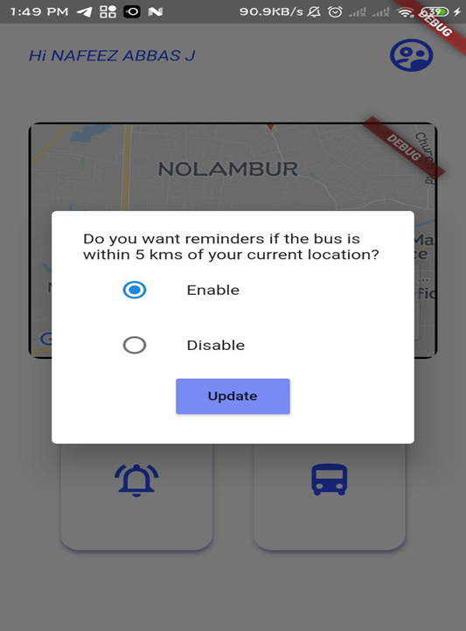
Screenshots

Slide 20
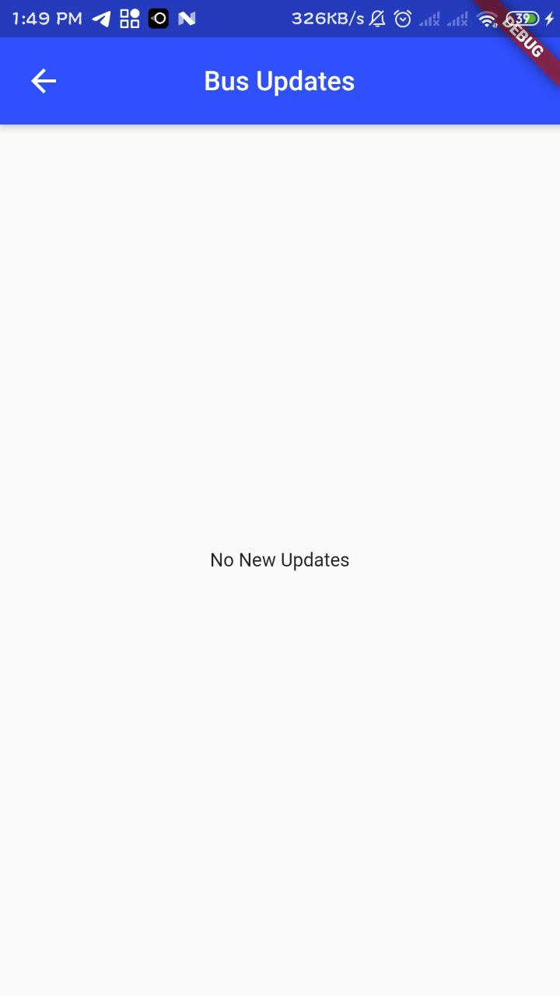
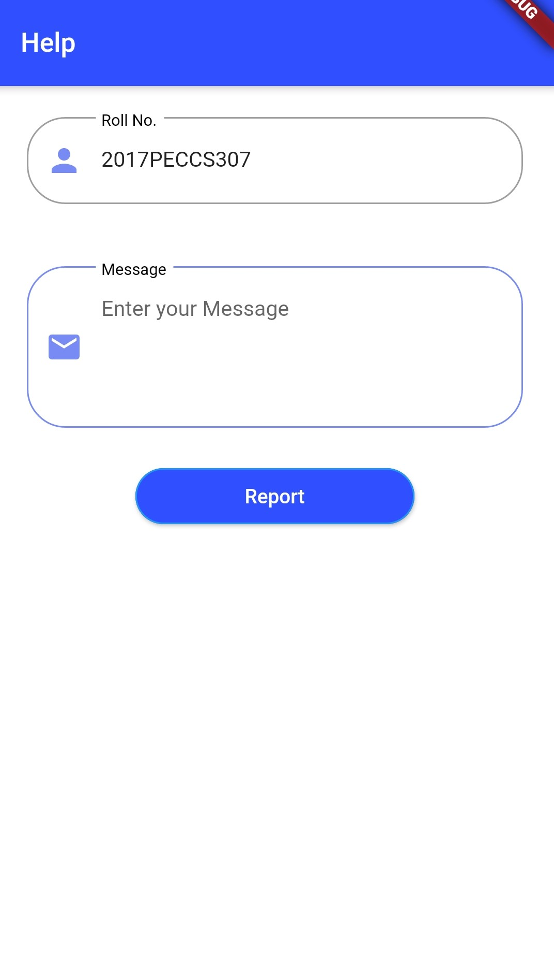
Screenshots

Slide 21
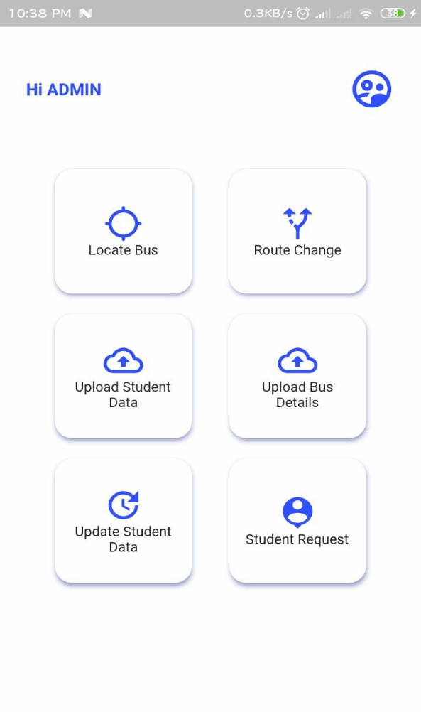
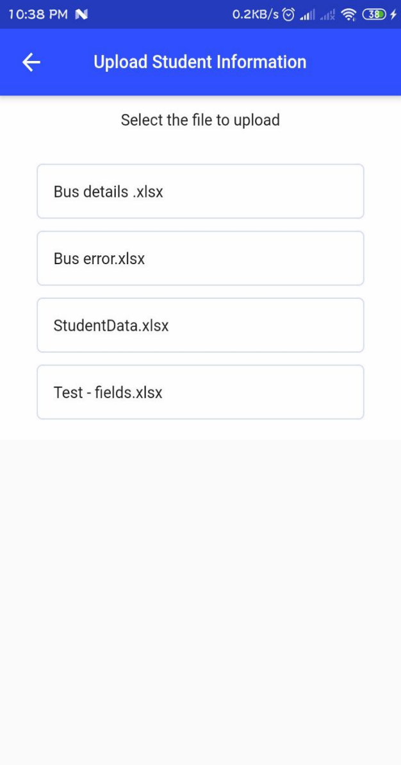
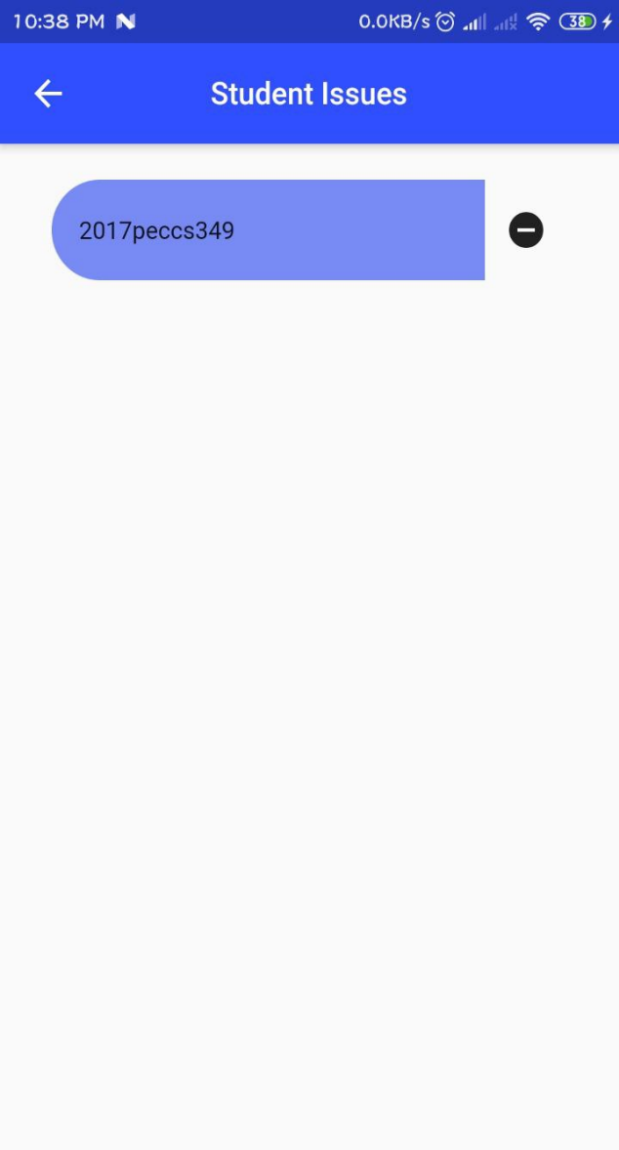
Screenshots

Slide 22
Conclusion
The conclusions of this study suggest that knowledge of specific domain improves the results. This Project has been implemented on Hybrid platform. Also, different attributes have been added to the project which will prove to be advantageous to the system. The requirements and specifications have been listed above.
This project is implemented using Android Studio with Flutter Framework and the Firebase. Using the GPS system, the application will automatically display the maps and routes to the different locations and also track the bus location using client-server technology and forward it to the client device.
It uses basic measurements of distance between two locations and provides necessary details of each and every route for people to easily pick up buses or any other conveyance possible on the specified route.
Specific location details are provided to the user along with bus number so that the student can identify the bus correctly. It uses remote server as its database. Due to this the records can be easily manipulated on the device itself and the server burden gets reduced.

Slide 23
Future Works
In future there will be an implementation for tracking a student’s location automatically and provide updates if student transfers from one bus to another. It will be very helpful to parents for tracking the student’s exact location.
There will be also Estimated Time of Arrival (ETA) of bus which makes the tracking app more precise to get bus location. There will be an individual login for teachers/staffs which will be implemented in future.

Slide 24
References
A. Goel noV. Gruhn," Fleet Monitoring System for Advanced Tracking of Economic Vehicles ", Procedures for 2006 IEEE International Conference on Systems, Man, and Cybernetics (SMC 2006), pages 2517-2522, Taipei, Taiwan, 08.10.2006-11.10.2006 .
Chia-Hung Lien, Chi-Hsiung Lin, Ying-Wen Bai, Ming-Fong Liu and Ming-Bo Lin, "Home Remote Control System for Home Energy Management," Continued on 2006 IEEE Tenth International Symposium on Consumer Electronics ISCE 2006), eSt. Petersburg, Russia, pages 7-12, June 28 - July 1, 2006.
Junaid Ali, Shaib Nasim, Taha Ali, Naveed Ahmed and syed Riaz un Nabi, "GSM implementation based on Commercial Automobile Tracker Using PIC 18F452 and Google Earth Embedded Development" Proceedings 2009 at the 2009 student conference IEEE on Research and development (SCOReD 2009), 16-18 Nov, 2009, UPM Serdang, Malaysia.

Slide 25
References
M. McDonald, H. Keller, J. Klijnhout and V. Mauro, “Intelligent Transport Systems in Europe: Opportunity for future Research” International Science publisher , ISBN 981270082X, 2006.
Muhammad Ali Mazidi, Janice Gillspie, McKinlay, Rolin D., "The Microcontroller in Embedded System: using Assembly and C," is the second edition published by Pearson Education. Panwar, Meenakshi and Mehra, Pawan. (2011),
B. Ferris, K. Watkins, and A. Borning, “Local tools to improve public transportation,” IEEE Pervasive Comput., Vol. 9, no. 1, pages. 13–19, January - March 2010.
B.aulfield and M.O’Mahony, “Assessment of users’ public transport information needs, ”IEEE Trans. Intell. Pass. Syst., Vol. 8, no. 1, pages 21-30, March 2007

Slide 26
References
M.Arikaa, S.Konomi, and K.Ohnishi, “Navitime: Supporting pedestrian walk in the real world,” IEEE Pervasive Comput., Vol. 6, no. 3, pages 21–29, Jul. - Sep. 2007.
K.Rehrl, S. Bruntsch, and H-J.Mentz, “Assisting Travelers: Development and Modeling of Private Travel,” IEEE Trans.. in Intelligent Transportation Systems, vol. 8, no. 1, pages 31-42, Mar 2007.
A. Repenning and A. Ioannidou, "Agents Agents: Guiding and Tracking Public Transportation Users," Proc. Working Conf. Advanced Visual Interfaces, ACM Press, 2006, pages 127-134.
Development of Mobile Applications for Posyandu Administration Services Using Google Maps API Geolocation Tagging published in 2018 International Conference on Sustainable Information Engineering and Technology (SIET).
Arduino Based Smart Energy Meter using GSM published in 2019 4th International Conference on Internet of Things: Smart Innovation and Usages (IoT-SIU).
Dart and Flutter Packages, https://pub.dev/

Slide 27
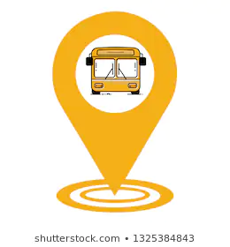
Thank you

